Slide 1
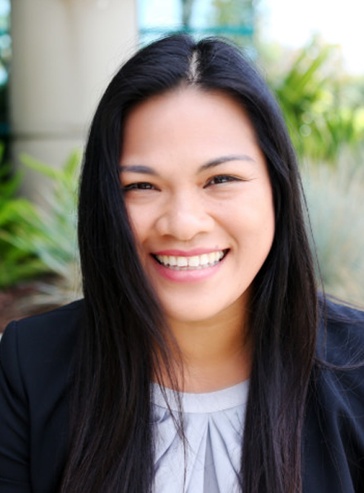
December Martin (Physics BS)
Senior Project Manager in Biomedical Technology
Stryker — Kalamazoo, MI
December calls her start in physics a “happy accident”; she was accepted to a rigorous, all-scholarship high school in the Philippines, studying science and math everyday.
She found a job at a biotech startup straight out of college. She traveled to several countries to teach science and English, and to support humanitarian work.
“The biggest driver I have every day is being able to make [a meaningful] connection out in the world to the work that I do,” she says.
Now, December is a project manager working on a device to treat brain aneurysms and strokes. She loves being able to help people, and is invigorated by the scientific community she works in:
“[Scientists and engineers] never say ‘when am I ever going to use this?’…This mentality is one I love and know I share with people in science”.

Slide 2
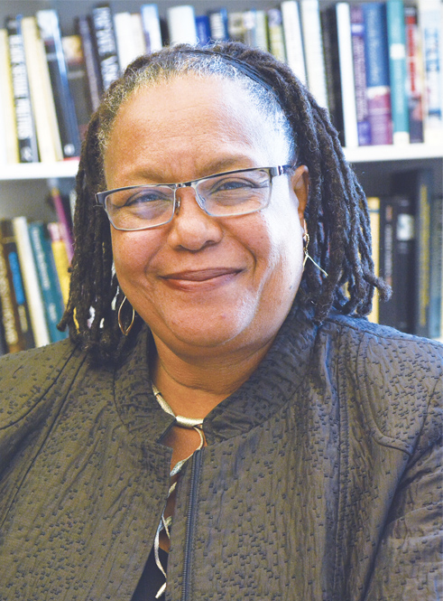
Evelynn Hammonds (Physics PhD)
Professor and Department Chair
Harvard College-Cambridge, MA
For Evelynn, there was no question that she was more interested in how physical things worked rather than studying questions about biology.
“From a very young age I was curious about how things worked in the world.”
In college, she spent her summers working in the Bell Laboratories Summer Research Program for Women and Minorities. She loved working in the lab, which motivated her to pursue graduate study in physics.
After getting a Master’s from MIT, Evelynn worked as a software engineer, then pursued a PhD in the history of science. Currently, Evelynn conducts research on the intersections of science, technology, race and gender, and has served as the first African-American female dean of Harvard College.
“I am drawn toward hard problems in the work I do, and I use my physics background to think about the kind of evidence I need to support specific policy decisions,” says Evelynn.

Slide 3
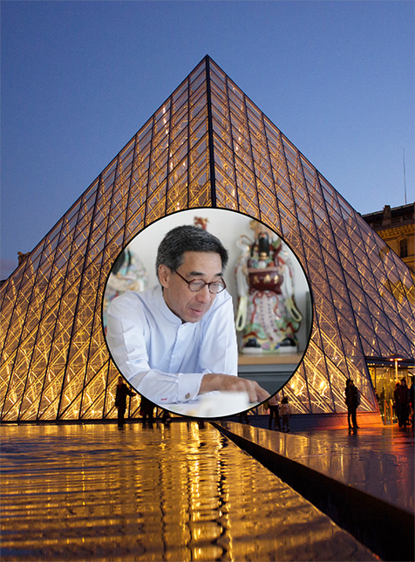
Chien Chung (Didi) Pei (Physics BA)
Architect and Co-Founder of Pei Partnership Architects
As a physics major at Harvard, Didi also took some art and architectural history courses. With his background in physics, and an interest in art and design, he decided to pursue a Masters in architecture.
Didi’s approach to architectural design merges science and art to produce award-winning structures. Studying physics has given Didi a sense of practicality and logic that you don’t usually learn when studying the arts.
“A lot of architects would like you to think that architecture is about being an artist, and you can do anything. But you have a responsibility as an architect…so having a logical thought process is useful,” says Didi.
Louvre: Benh Lieu Song
Didi has contributed to designs all over the world, including the Grand Louvre in Paris.
“I had acquired really rigorous training in the scientific method. There aren’t many architects who had that, and it’s been very useful to me throughout my career.”

Slide 4
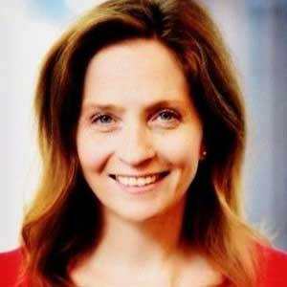
Amy Ziegler (Physics BS)
Intellectual Property Attorney
An excellent high school physics teacher led to Amy’s interest in physics. She won several prizes at science fairs, and these experiences played a substantial role in her decision to study physics in college.
After earning her Bachelor’s degree, she began working at Argonne National Lab. She learned that research topics are often determined by available funding, not just personal interests. Wanting a career with more autonomy and variety, she decided to attend law school, and is now an intellectual property lawyer.
“I like what I do, I like the legal work, but I also like applying technology to try to make our processes better and more efficient.”
Amy found the disciplines and logical thinking skills learned through her physics background to be especially helpful when researching highly specialized inventions for patent applications.
“Physics is not an easy subject, so for anybody who can do that, you can learn almost anything else.”

Slide 5
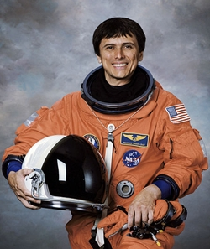
Franklin Chang-Diaz (Plasma Physics PhD)
Astronaut and Founder and CEO of Ad Astra Rocket Company
Born in Costa Rica and raised during the Cold War era, Franklin was captivated by the Sputnik satellite and the beginnings of space exploration.
“I felt one day humans would travel to distance planets, and I wanted to be one of those travelers…That was the beginning-my earliest memories of being fascinated by space.”
After graduating high school in Costa Rica, Franklin immigrated to the US and started high school all over again, eventually earning a full ride scholarship to the University of Connecticut for engineering.
NASA cancelled its space flight program shortly after the moon landing, and Franklin used the opportunity to earn his PhD in Plasma Physics at MIT. When the Space Program returned in 1977, he applied for astronaut recruitment, and finally got his chance to go to space, becoming one of the first scientists to fly without a military background.
“When I first started, it was clear that being a scientist made you less likely to fly. But that didn’t seem right to me,” Franklin says. “Throughout my years in the astronaut corps, I think I helped bridge that gap.

Slide 6
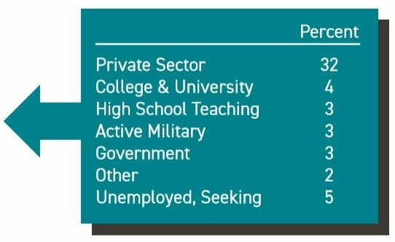
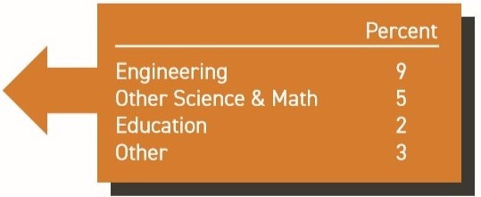
DID YOU KNOW?
Physics Degrees Get Jobs!
Physics Bachelors One Year Later
In 2017 and 2018, 52% of physics bachelor’s recipients went straight into the job market, with starting salaries of $50K-$70K in the private sector
48% of physics bachelors went to graduate school
19% studied something other than physics or astronomy, primarily engineering or math
WORKFORCE
GRADUATE STUDY
ASTRONOMY OR PHYSICS
GRADUATE STUDY
OTHER FIELDS
Learn more: aip.org/statistics

Slide 7
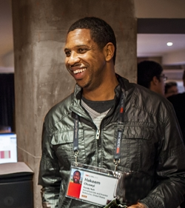
Hakeem Oluseyi (Physics PhD)
Professor at Florida Institute of Technology
Hakeem moved between rough neighborhoods as a kid and spent a lot of time indoors watching PBS and reading.
“I discovered Jacques Cousteau on TV and Albert Einstein in my reading. The effects of relativity just knocked my socks off!...I thought, ‘Man! Scientists are super cool!’”
When a science fair judge told him he should become a physicist, Hakeem dismissed the idea, and chose to enlist in the Navy. But them, he decided to major in physics, eventually earning his PhD from Stanford.
After finishing school, Hakeem worked in Silicon Valley, researching the manufacturing of computer chips, earning 8 U.S patents and 4 E.U patents. Today, he is a professor at the Florida Institute of Technology, and a member of the team developing the Large Synoptic Survey Telescope. He also visits sub-Saharan African schools through an organization called Cosmos Education, inspiring students with science demonstrations.
“I find service to students and humanity as exciting as making a new scientific discovery. That is my life – I educate, I inspire, and I research,” Hakeem says.

Slide 8
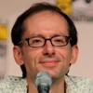
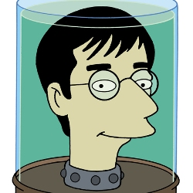
David X. Cohen (Physics BA)
Writer and Executive Producer of Futurama
David grew up in a house of “natural” science, but although his parents were both biology majors, David found he was more interested in physics and computer science.
“Physics seemed more unchanging to me, more eternally useful, and I felt like I would have more options afterwards by majoring in physics,” David says.
Graduating from Harvard, where he was the president of Harvard Lampoon, he started graduate career in computer science. But reaching a dead end in his research project forced him to think what he wants to do next, start a new project, or do something else. With a personal interest in humor and a fondness for writing, David started writing sample scripts for TV shows, and eventually started writing for The Simpsons, and later launching Futurama.
David says his physics education made him feel like he “was forced to work very hard, and to think hard and logically, and to try to understand the process behind the correct answer…and those things come in handy no matter what you do.”
Drawing by Matt Groening

Slide 9
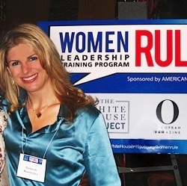
Deborah Berebichez (Physics PhD)
Vice President of Risk Analytics at Morgan Stanley
Debbie grew up in a conservative community in Mexico City that strongly discouraged girls from pursuing careers in science. She received a scholarship to study philosophy at Brandeis University, but fell in love with physics while taking an intro level astronomy course.
During her senior year, she realized she couldn’t live with herself without having tried to study physics, but her scholarship would run out before she had the chance. The physics department allowed her to skip the first two years of the physics major requirements if she could teach herself the material in one summer. She was successful and completed her physics degree before her scholarship ended.
After becoming the first Mexican woman to graduate from Stanford with a physics PhD, Debbie went to Wall street to become a quantitative risk analyst, using math models to manage the financial risk of investments.
“I would love to become a female role model for those girls who love science but somehow feel trapped, like they can’t achieve their dreams,” Debbie says. “I want to become the new ‘Oprah’ of science.”

Slide 10
Brett Gilbert (Physics BS)
Lawyer, Assistant Dean at Touro Law Center
A passion for stargazing and a love of science fiction fueled Brett’s curiosity and questions about the universe.
“My parents gave me a Newtonian reflector when I was a freshman in high school, and I loved taking it out and observing planets and stars.”
After graduating from the University of Toledo in Ohio with a BS in Physics, Brett went on to attend an Astronomy PhD program at Boston University. A year later, however, he realized he might be better suited to a different field of study, philosophy, and left the program.
Brett eventually went to law school, and became a criminal defense attorney in New York City.
“Physics certainly helped prepare me to study philosophy, and particularly law school, [where] clear and concise thought and argument is most appreciated.”

Slide 11
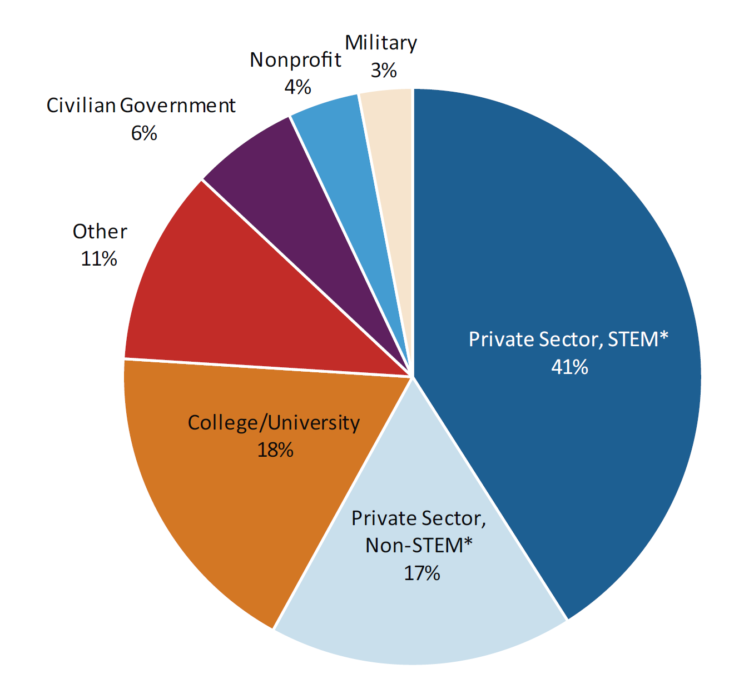
DID YOU KNOW?
Astronomy Bachelors Open Doors!
Initial Employment Sectors of Astronomy Bachelors
Nonprofit
4%
Military
3%
In 2014, 2015 and 2016, 50% of astronomy bachelors entered the job market.
Of those, nearly 60% were employed in the private sector.
The majority of private sector jobs, over 70%, were in STEM* fields, with a median salary of over $50K.
Civilian Government
6%
Other
11%
Private Sector STEM
41%
College/
University
18%
Private Sector
Non-STEM
17%
*STEM stands for science, technology, engineering and math
Learn more: aip.org/statistics

Slide 12
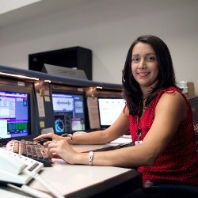
Ginger Kerrick (Physics MSc)
NASA Flight Director
When Ginger went to the library with her father, she found an astronomy book that had a section about space travel. At just 5 years old, Ginger knew she wanted to be an astronaut and nothing else.
After graduating from Texas Tech, Ginger applied to be an astronaut at NASA, but didn’t make it past the final cut. Instead, she became a Capsule Communicator, communicating directly with astronauts while they are in space.
Ginger is now the first Hispanic female NASA Flight Director, working on the plans and tasks that astronauts have to do in space.
Ginger has to be able to see a problem before it even comes up, and already have a plan ready to solve the problem. Her physics knowledge gives her the ability to think beyond the usual and provide valuable insight on solving unexpected problems.

Slide 13
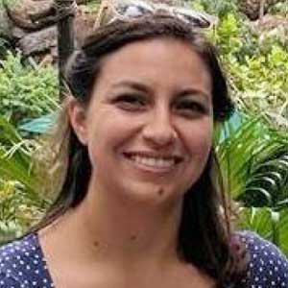
Jacqueline Benitez (Physics BS)
Distance Learning Educator, California Academy of Sciences
Although Jacque was fascinated by astronomy, she struggled with physics throughout high school and college. But instead of quitting, she decided to try one more physics class in college. This time, it started to click, and Jacque realized the difference a skilled and dedicated instructor could make.
“It was all about just wanting more knowledge about the world around me and about astronomy.”
After graduating, she found an internship position at the California Academy of Sciences Education Department involving virtual interactions.
As a distance learning education specialist, Jacque spends most of her morning during the school year facilitating science learning over Zoom, teaching a range of subjects. Using her physics training, she has developed interesting engineering techniques and hands-on experiences for her classroom.
“For me, it’s all about giving [students who] wouldn’t get to come here to the Academy of Sciences a taste of what it’s like to be a scientist,” she says.

Slide 14
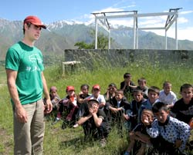
Middy Tilghman (Physics BA)
Co-Founder and Director of Tajikistan Youth Camp Lageri Amerikoii
Middy was an avid kayaker and outdoors fan growing up. And while he liked most of his classes, math and science were always his favorites.
After graduating from Wesleyan with a Bachelor of Arts in physics, Middy moved to France to teach English and pursue competitive whitewater kayaking.
Middy with campers fro Lageri Amerikoii
While kayaking the rivers of Tajikistan, he joined a non-profit organization working to improve the country’s water sanitation. He also helped found Lageri Amerikoii-Tajik for Camp America - a summer camp for Tajik children. At Lageri Aerimkoii, children get to rock climb, play sports, and participate in a variety of activities they might otherwise never have experienced.
Middy credits his physics education for teaching him how to work hard and pursue his diverse interests.
“For me,” Middy says, “physics was not the specific set of skills I needed for my career, but it gave me a great set of foundational tools which I can use to learn other necessary skills.”

Slide 15
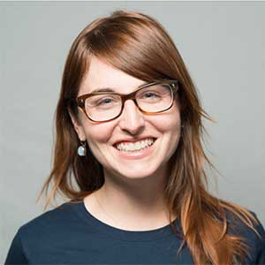
Jessica Kirkpatrick (Astrophysics PhD)
Director of Data Science and Digital Exploration at KoBold Metals
Neither of Jessica’s parents worked in technical fields, so it wasn’t until her first physics class in high school that she realized how physics uses math to understand the world. She did so well in her AP Physics class, that her teacher told her to pursue physics in college.
“That was the first time a teacher had ever said to me, ‘You have a talent, you should do this,” Jessica says.
After earning her PhD in Astrophysics at UC Berkeley, Jessica applied to a variety of jobs, eventually choosing to work in the tech industry.
“What attracted me to tech in particular was that it felt like a good way to apply my technical skills but in a way that was more down to earth.”
She has since worked as a data scientist at a variety of companies, including Microsoft, Chegg, and Slack. Now, as Director of Data Science and Digital Exploration at KoBold Metals, she focuses on modeling and machine learning.
“[Data science is] really fun because I’m constantly working on different areas and different focuses.”

Slide 16
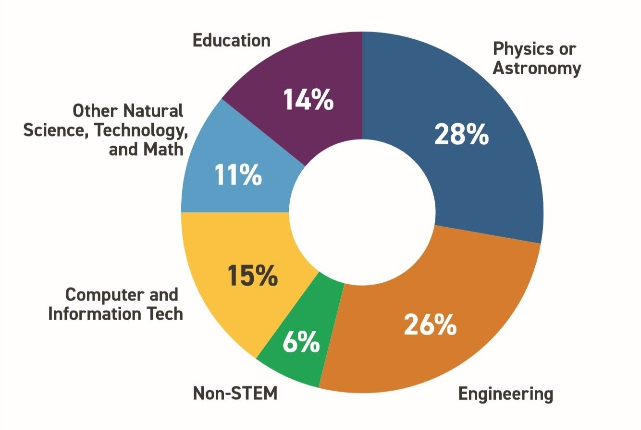
DID YOU KNOW?
A Master’s Degree in Physics Open Doors to All Type of Careers!
Employment Fields for New Physics Masters
In 2019, nearly 60% of graduating physics masters entered the workforce.
Over half of employed physics masters were in the private sector, with median salaries between $55K-$75K
Over 40% were working in either engineering or computer and information technology.
Learn more: aip.org/statistics

Slide 17
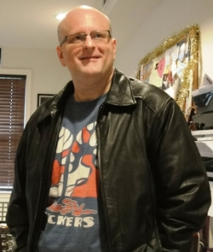
Mike Long (Physics BS)
Speechwriter and Comedian
Mike’s first love was writing, but he didn’t see a future career in it, so he set his sights on neuroscience. Things changed after his senior year of high school, when he took his first physics class.
“I though ‘oh my goodness, this is so much better than biology’,” Mike says. “It’s a different, clarified way to look at the world, and I really enjoyed it.”
Mike started doing standup comedy while in graduate school and liked it so much that he dropped out of school to pursue comedy full time.
Comedy didn’t work out, so Mike returned to writing, eventually pursuing a career in political writing in Washington, DC. Since then, he has worked as a personal speechwriter for a senator, penned five plays, written numerous books and consulted for Saturday Night Live and The Onion.
“Physics teaches you how to think, how to break something down to find its flaws, and reassemble it,” Mike says. “It makes you a thoughtful and critical writer…Physics is what made me an unusual and successful writer.”

Slide 18
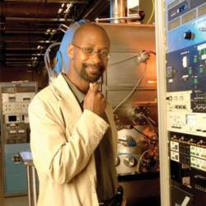
Paul Markoff-Johnson (Physics BS)
Engineer at Intevac
Paul’s interest in science and math started at an early age, but really took off after his first physics class in high school.
“Suddenly having an ability to explain the things I’m seeing around me with physics, like why a car goes, was really exciting to me,” Paul said.
Paul thought he would major in engineering in college, but decided he wanted to study something broader, so he switched to physics. Paul believed physics would broaden his career options, and would help him in succeed in a variety of fields.
“You get that ability to walk into strange situations, unfamiliar situations, and think from what I call basic principles; to use a basic understanding of how the world works in order to solve the problem.”
Now, Paul uses thin coatings of materials for a variety of purposes, such as making an MP3 player hold more songs, or creating less expensive solar cells.
“If I’m successful, if [the solar power] industry is successful, we will have changed the world for the better.”

Slide 19
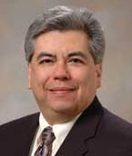
Carlos Gutierrez (Physics PhD)
Professor of Materials Physics at Texas State University, San Marcos
Carlos first became interested in science listening to the Aztec folktales his grandmother told him as a child. The astronomy in those stories inspired him to study the stars.
While in graduate school, Carlos became interested in materials physics, and how observation and detection technology works.
“I just wanted to know how everything worked,” he says.
Now a professor at Texas State University, San Marcos, Carlos collaborates with engineers and industry studying materials with properties that might be useful for sensors in areas from telecommunications to microelectronics.
In college, Carlos had a hard time finding Hispanic physicists to be his role models. Now, he strives to provide students with an example of a successful minority physicists and supporting college students through his role as faculty advisor to the Society of Mexican-American Engineers and Scientists, and the Society for the Advancement of Chicanos and Native Americans in Science.
“I do what I can to let the student know that if they really are interested in physics, that it is a viable and exciting career,” he says.

Slide 20
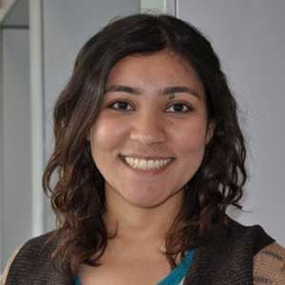
Zahra Hussaini (Physics BS)
Site Reliability Engineer at Google
At Arizona State, Zahra began as a premed major, because her family pressured her toward a physician or lawyer careers. She soon switched to materials engineering, but still felt that she was not gaining the deeper understanding of the world that she desired. So she switched again to physics.
After graduating, Zahra got a job at NIST, but soon learned that she was not interested in a research career, deciding that she wanted to work for a tech company instead.
“My motivation was just that I didn’t want to be…the best programmer in the room. I wanted to be around people that could teach me and where I could learn,” she explains.
Zahra eventually found a job as a software engineer at Google, working on satellite imagery. Now, she is a site reliability engineer, focusing on the reliability and maintainability of large systems.
“I think physics is an awesome degree because it teaches you a way of problem solving that is applicable to so many different fields.”

Slide 21
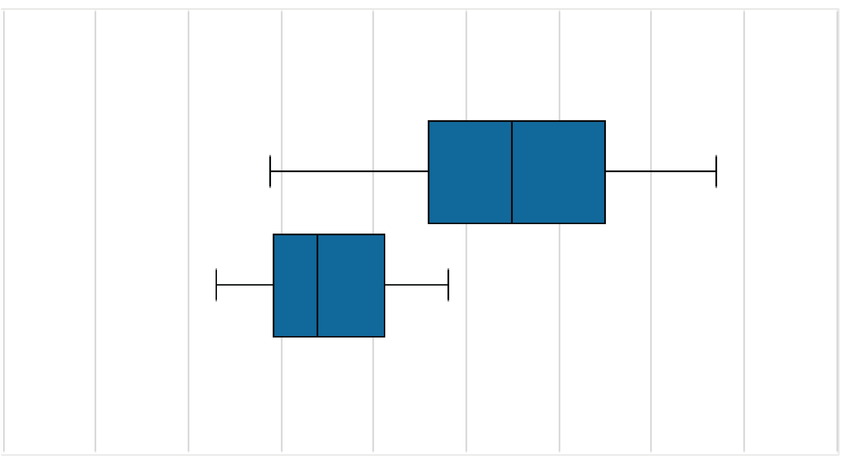
DID YOU KNOW?
An Astronomy Bachelors Degree Pays
Starting Salaries for Astronomy Bachelors (2014, 2015, 2016)
Salaries (in thousands)
In 2014, 2015 and 2016, 50% of astronomy bachelors entered the job market.
Of those, over half were employed in the private sector.
The majority of private sector jobs, over 70%, were in STEM fields, with a median salary of over $50K
$0 $10 $20 $30 $40 $50 $60 $70 $80 $90
Employment Sector
Private Sector
STEM
College or
University
Learn more: aip.org/statistics

Slide 22
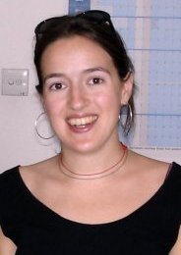
Alison Binkowski (Physics BS)
Policy Analyst at the Government Accountability Office
Alison “was always interested in how the world worked: from why objects fall to what was at the ‘edge’ of the universe.”
Alison has a passion for international health care issues that have led to volunteering experiences throughout the world, including at a clinic in Costa Rica, at an international non-governmental organization in China, and in Senegal and Mali with the United Nations.
Now, Alison works as a policy analyst for the Government Accountability Office. Her physics training has given her powerful critical thinking skills, that she uses to find creative solutions to complex policy problems.
“Many fields – including international development and health policy – need more people with strong analytic backgrounds,” she says. “My analytic training helped me stand out from other candidates to get my current job at the GAO”

Slide 23
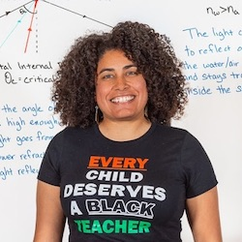
Desiré Whitmore (Chemical and Material Physics PhD)
Senior Physics Educator at Exploratorium
Desiré always enjoyed learning about science, engineering and math, in particular taking things apart and putting them back together. She majored in chemical engineering in college but found that the courses were not as stimulating as her introductory physics classes had been.
In grad school, Desiré realized that she also loved teaching while working at a local kids’ museum. After completing her postdoc at UC Berkeley, she decided to look for a job in teaching.
“I like taking really complex ideas and turning them into something that a [layperson] can understand, including a child,” she says.
At the Exploratorium in San Francisco, Desiré works on public programing, exhibit development, training employees and professional development experiences for middle and high school teachers.
“I get to go down to the museum floor and play with the exhibits…to figure out [the best concepts that I can teach,” Desiré says. “You can teach a whole week’s worth of lessons on one exhibit.”

Slide 24
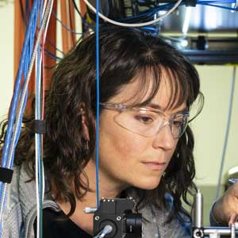
Julia Scherschligt (Physics MS)
Physicist at National Institute of Standards and Technology
In high school, Julia like the objective nature of physics, and went on to study physics and math in college. After graduating, she was unsure of career options for bachelor’s degree recipients, so she decided to go to graduate school.
Julia found that graduate school did not fit her needs and chose not to continue after earning her Master’s degree. She still loved physics and found a position at the National Institute of Standards and Technology (NIST), supporting users of the neutron facility.
“I was super happy to be back in physics…It was like sort of a customer service role but with a lot of technical content.”
Julia has worked in several groups at NIST, and currently works in the thermodynamic metrology group, and has risen to lead the team, which focuses on temperature, pressure and humidity.
“I call us the ‘Custodians of the Kelvin in America,” Julia says. “…Any sort of temperature measurement device is tied back to measurements that are done either at NIST or at the equivalent of NIST in [another country].”

Slide 25
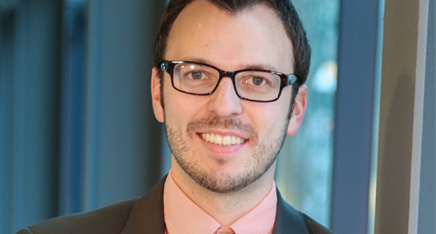
Nathan Swift (Physics BS)
Chief Operating Officer of Hedgemon
Nathan liked physics in high school because he was “really bad at memorization, but good at deriving.”
After graduating, Nathan went back to school to get his Master of Science in Physics Entrepreneurship, a program offered at Case Western Reserve University. As part of his degree, he co-founded the company Hedgemon with his friends, using biomimicry to design protection technologies, like football helmets.
Nathan feels that “physics training teaches far more than just the physics and math, because it enhances how I approach problems and concepts: breaking them down into simpler parts, starting with what I know, and methodically working my way to a solution.”
Nathan uses these problem-solving skills as Chief Operations Officer of Hedgemon, a job that includes operational tasks like accounting and fundraising, as well as technical and research work.

Slide 26
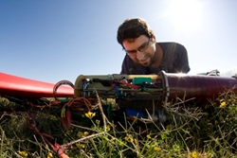
Kenny Jensen (Physics PhD)
Wind Power Startup Engineer at Makani Power
Kenny is an inventor at heart and loved the freedom physics gave him to use all his creative and innovative skills.
“[To] create truly new inventions, you need to understand how and why things work down to the last detail, which requires physics.”
Kenny studied carbon nanotubes, and their receiving properties as nanoradios, while earning his PhD from the University of California, Berkeley.
Now, Kenny works at the wind-power startup company Makani Power. Makani Power harvests high altitude wind energy using unmanned aircraft flying at high altitudes. Kenny’s job is to design the systems that control these aircraft.
“Energy will be one of the great problems facing humanity in the 21st century,” Kenny says. “And physicists, with their strong technical background and physical intuition, are especially well positioned to attack this problem.”
Although Kenny doesn’t have an engineering degree, his physics education has more than equipped him for success in his current job.

Slide 27
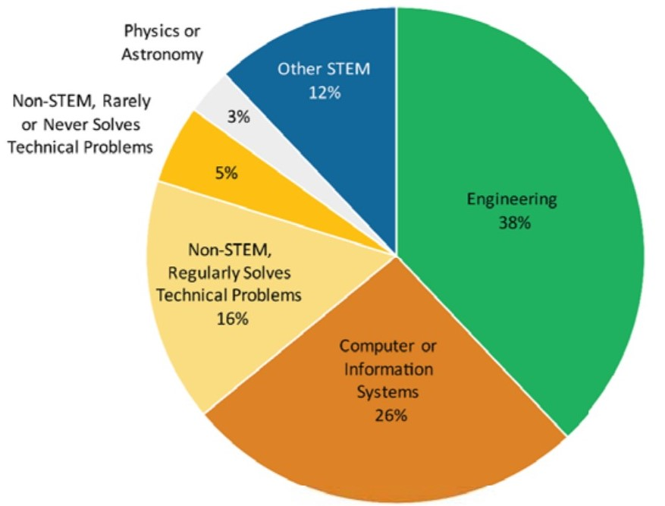
DID YOU KNOW?
Physics Bachelors Work All Kinds of Jobs, mostly in STEM*
Field of Employment for New Physics Bachelors in the Private Sector
In 2017 and 2018, over half of graduating physics bachelors entered the job market.
Of those, about two thirds were employed in the private sector, with the majority working in engineering or computer science jobs.
Most private sector jobs, nearly 80%, were in STEM* fields, with starting salaries between $50K-$70K
Physics or
Astronomy
Non-Stem, Rarely
Or Never Solves
Technical Problems
Other STEM
12%
3%
5%
Engineering
38%
Non-Stem,
Regularly Solves
Technical Problems
16%
Computer or Information Systems
26%
*STEM fields are Science, Technology, Engineering and Math
Learn more: aip.org/statistics

Slide 28
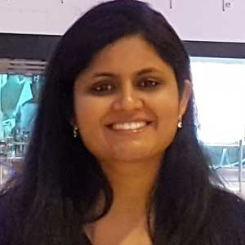
Neha Pachauri (Physics PhD)
Process Technology Development Engineer at Intel
Growing up in India, Neha chose to study science because it has good job prospects, and her curiosity drove her to study physics in college.
Neha taught undergraduate physics for two years after earning her Master’s in India, before coming to the U.S for her PhD in experimental condensed matter. Although she didn’t know much about it, she wanted to explore a career in industry.
“I wanted to explore real world applications of my research work and get industrial experience,” Neha says.
At Intel, Neha works in the fabrication facility on turning wafers into microprocessors. She also researches new production techniques. Neha’s background in physics has helped prepare her for conducting experiments, analyzing data, and understanding and improving upcoming technology.
“The skills I learned during my research were really transferable to what I saw in the job profile [at Intel],” she says.

Slide 29
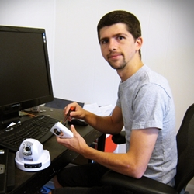
Rhett Creighton (Physics BS)
Co-Founder of Camm Security, Inc.
Rhett’s belief that a physics major would provide him a broad base of skills he could apply to any task has paid off with a varied career as an entrepreneur and engineer.
“I wanted to be able to invent things and solve problems without being bounded by current engineering conventions or practices,” Rhett says.
As an undergraduate, Rhett used his developing technical know-how to build web businesses and competition winning robots and run for student office.
After graduating with a Master’s in Nuclear Engineering, Rhett has worked in consulting, and started several companies, including Camm Security Inc., a company that develops video security cameras, and GitHire, a service that matches programmers to companies that need them. Through it all, Rhett has used his physics training to tackle problems he finds interesting.
“I’m always able to tackle and solve a problem using the mathematical, analytical, and software modeling tools I used in physics.”

Slide 30
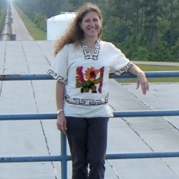
Gabriela González (Physics PhD)
Professor at Louisiana State University
Gabriela initially wanted to be a math teacher, like her mother. But her first physics class in high school changed that.
“I was amazed at how we could ‘explain’ the world with physics, and we could predict what objects would do. When I found out this also applied to stars and the universe and that there were unknown phenomena waiting to be discovered, I decided I couldn’t do anything else!”
After going to college in her home country of Argentina, Gabriela moved to Syracuse University for her PhD, focusing on gravitational waves.
Now, Gabriela still work on gravitational waves at LIGO in Livingston, Louisiana, and is a professor of physics and astronomy at Louisiana State University. She says that learning how to get help from experts and how to successfully work with others were just as important as the physics concepts she learned.
“The best lesson from [my training] was learning to ask questions – always ask ‘Why?!’”

Slide 31
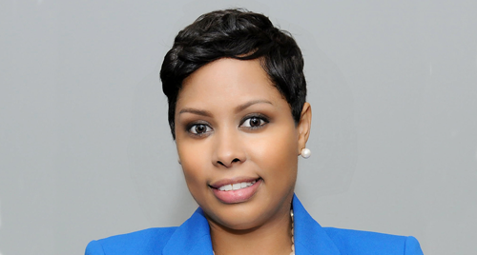
Tracee Walker Gilbert (Physics BS)
Owner and Operator of Systems Innovation, LLC
Coming from a family of writers, musicians and teachers, Tracee calls herself an “anomaly.” But being surrounded by creativity and early exposure to math and science led to a desire to do physics.
“I always had a passion for solving problems, really tough problems,” Tracee admits.
After earning her bachelor’s in physics, Tracee did a little bit of everything. She worked for a series of companies and took a leave of absence to earn her PhD in Industrial and Systems Engineering, before getting a fellowship with the American Association for the Advancement of Science.
Finally, Tracee launched her own company, System Innovation, providing management and technology consulting, systems engineering services, and research and development oversight. Starting her own business was a long-time dream, and Tracee feels that her physics degree gave her the skills she needed to be successful.
“[Physics] really gives you the critical thinking and logical reasoning skills that are needed to not only be innovative, but to be a problem solver,” she says. “You can go anywhere with a physics degree. If you start off with a business degree, it’s harder to go in the other direction. Most things were easy for me to learn having the physics foundation.”

